Slide 1


What We Selected
Front end of an Education Website
Content
Home Page
Courses
Contact
About

Slide 2
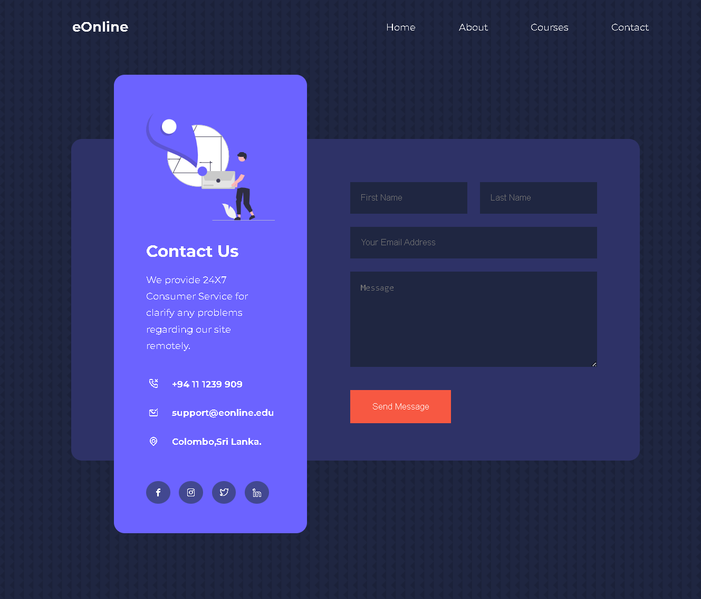
Contact Page

